Slide 1
Project Report: Statistical Arbitrage
Shubham Patil • 19-03-2020
Eckovation
Machine Learning

Slide 2
Overview
Deep Learning Strategy
RNN Overview
Feature and Label Generation
Model Formation
Strategy
Results
Statistical Arbitrage Strategy
Statistical Arbitrage Overview
Finding Correlated Pairs
Stochastic Control
Parameter Tuning
Results

Slide 3
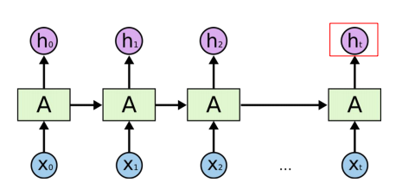
Recurrent Neural Networks (RNN)
What is RNN?
Family of Neural Network specialized for sequence data.
‘Many-to-One’ architecture.
‘Vanilla’ vs. Long short-term memory (LSTM)

Slide 4

RNN: Feature and Label Generation
Feature
Bid/Ask Prices and Spread (10 levels)
Volumes (10 levels)
Mean Prices and Volumes
Accumulated Price and Volume Differences
Price and Volume Changes
Order Imbalance Changes
VWAP
Label Generation
Mid-Price Movement
Volume Weighted Average Price (VWAP) Movement
Settled on classifying VWAP movement over the next time ‘window’

Slide 5

RNN: Model Formation
Model:
Cost Function: Weighted Cross Entropy ○ Helps solve challenge of having an imbalanced dataset
Output: Softmax Layer Outputs a predicted probability for each label
Unit: LSTM Long short-term memory (LSTM) units to model longer term dependencies
Hyperparameter:
Number of Units
Prediction Window for Label
Trade Probability Cutoff
Cross Entropy Weights
Other (e.g. Learning Rate, Dropout)

Slide 6
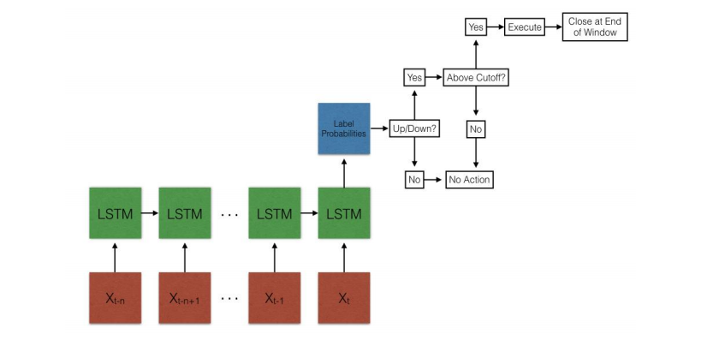
RNN: Strategy

Slide 7
Statistical Arbitrage Strategy

Slide 8

Baseline model
Linearly regress the mid-price returns of a pair of historically correlated stocks.
This type of trading strategy assigns stocks a desirability ranking and then constructs a portfolio to reduce risk as much as possible.
Statistical arbitrage is heavily reliant on computer models and analysis and is known as one of the most rigorous approach to investing.

Slide 9
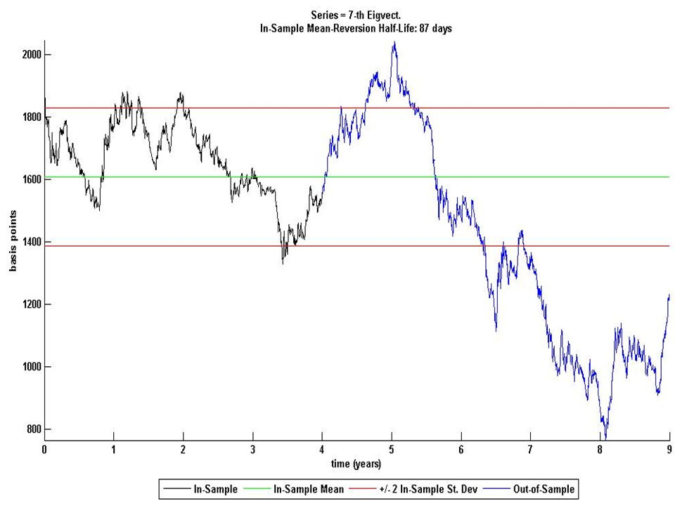
Example of execution process

Slide 10

What's new?
Identifying most correlated pairs to trade
Stochastic control to incorporate dynamically optimal thresholds
Hyperparameter tuning (frequency, training size, leverage, etc.)

Slide 11
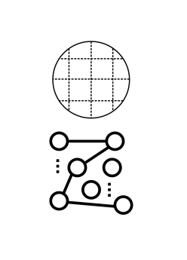
Parameter Tuning
Two approaches to parameter tuning:
● Grid search ○ Systematic exploration ○ Enables for sensitivity analysis ○ Inefficient
● Random search ○ Black-box method ○ Explore larger subspace

Slide 12

Validation set
● Evaluated 4 models a. Fixed thresholds, pairs picked by performance b. Fixed thresholds, pairs picked by correlation c. Stochastic control thresholds, pairs picked by performance d. Stochastic control thresholds, pairs picked by correlation
● Model a. performed best on validation set

Slide 13
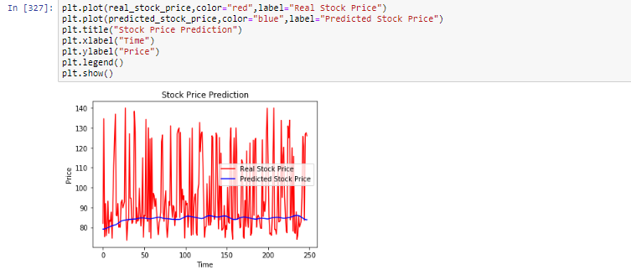
Test Set Result

Slide 14

Future Work
To trade based on factors from PCA eigen portfolio and its eigenvalues: ○ take a variable number of eigenvectors, truncate to explain a given percentage of the total variance of the system
Implement a more dynamic strategy ○ Using the correlation from yesterday to decide which pairs to trade today. ○ Or observe the market for a couple of hours and then start trading based on earlier correlation

Slide 15
Thank You.
Shubham Balasaheb Patil Eckovation Machine Learning

